Slide 1
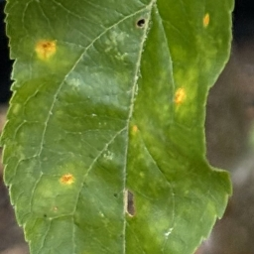
Cedar Apple Rust Image Classification
Evan Apinis

Slide 2
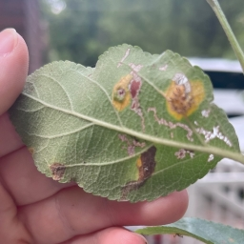
Problem Statement
Problem:
This past spring my apple trees showed diseased leaves
Having not grown apple trees before I was unsure of the specific disease type
Goal:
Train an ML model with diseased apple tree leaves to identify the disease type

Slide 3
Related Work
Researchers from Penn State used the PlantVillage dataset and an AlexNet and GoogLeNet model to achieve 99.35% testing set accuracy (includes apple leaves) [1]
Supervised and unsupervised models have been applied to identify plant diseases (does not include apple leaves) [2]
[1] Frontiers | Using Deep Learning for Image-Based Plant Disease Detection
[2] https://www.researchgate.net/publication/337023535_Plant_Disease_Identification_and_Classification_using_Image_Processing

Slide 4
Approach
Using the New Plant Diseases Dataset from Kaggle (87k images)
38 classes across 14 plant species including apple tree leaves and diseases
Predefined 80/20 split for training/testing datasets
Testing set is split for verification and testing 70/30
Improves data augmentation from PlantVillage dataset with rotation and backgrounds
Implementing ResNet-18 model for dataset to attempt to achieve high accuracy

Slide 5
ResNet-18 Model Configuration
Train and Test loaders transformed to 256x256 pixel images with 0.5 mean and 0.5 standard deviation
Default ResNet-18 model weights used
Batch sizes of 32 with ResNet-18 used ~6GB of VRAM
Model was moved to GPU with DirectML Torch library
The model was trained for ten epochs and used a verification dataset for each epoch for testing performance
Final accuracy testing was performed with an independent testing dataset unfamiliar to the model

Slide 6
Model Training Results
Epoch | Training Accuracy | Training Loss | Testing Accuracy | Testing Loss
1 | 93.70% | 0.3159 | 98.84% | 0.0443
2 | 99.11% | 0.0402 | 99.36% | 0.0241
3 | 99.59% | 0.0212 | 99.32% | 0.0219
4 | 99.75% | 0.0142 | 99.52% | 0.0165
5 | 99.85% | 0.0100 | 99.53% | 0.0143
6 | 99.90% | 0.0074 | 99.61% | 0.0126
7 | 99.95% | 0.0054 | 99.61% | 0.0123
8 | 99.96% | 0.0046 | 99.62% | 0.0121
9 | 99.97% | 0.0037 | 99.66% | 0.0119
10 | 99.97% | 0.0033 | 99.70% | 0.0109

Slide 7
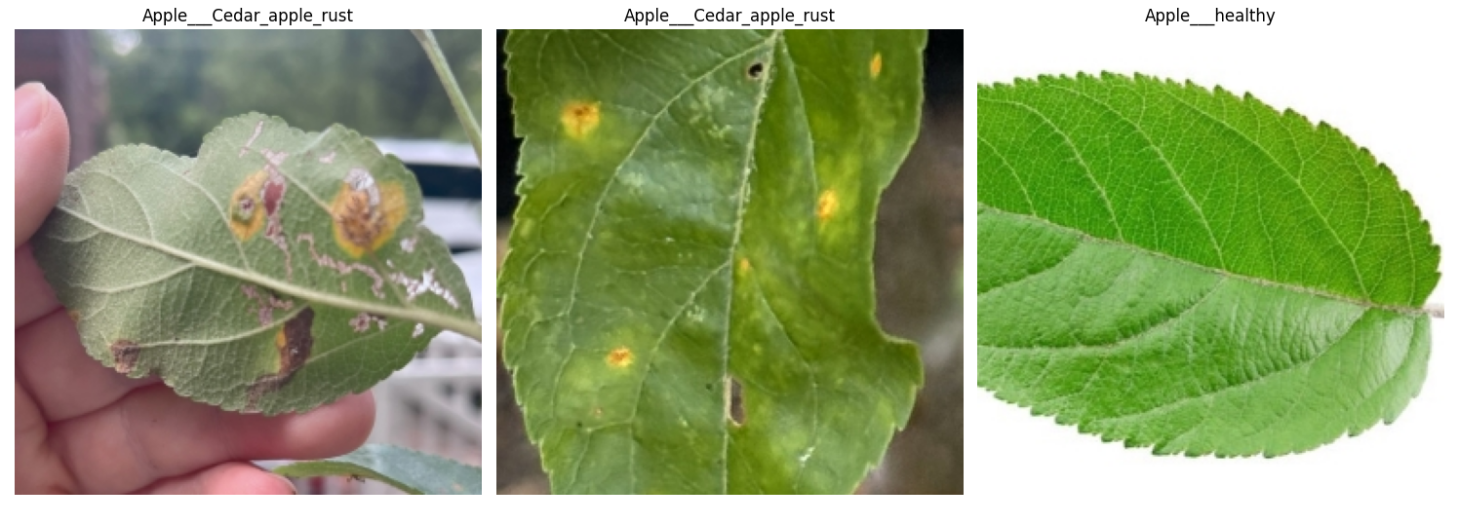
Classification Results
Provided the model with three images to classify
Two diseased leaves with their predicted label and a healthy stock image

Slide 8
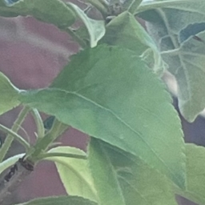
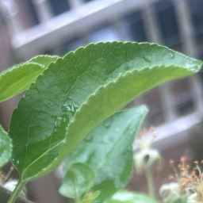
Misclassification Issues
Tomato Healthy
I attempted to predict the labels for two images I had of healthy leaves on my tree
Both images were incorrectly identified as healthy leaf variants of other plants
Blueberry Healthy

Slide 9
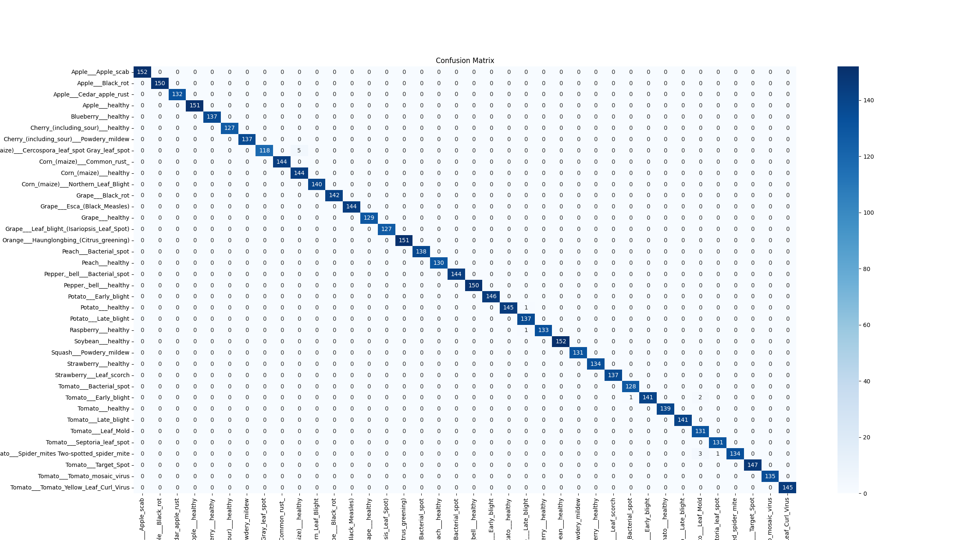
Confusion Matrix

Slide 10
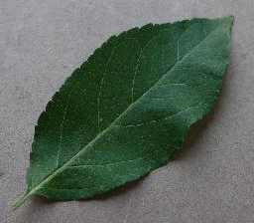
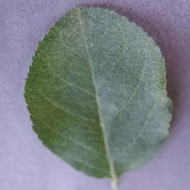
Classification Report + Training Images
Classification report again disputes my hypothesis about healthy leaf misclassification
Training images show that leaves used were flat
Quality of test images used likely contributed to misclassification
Leaf | Precision | Recall | F1-Score | Support
Apple Scab | 1.00 | 1.00 | 1.00 | 152
Apple Black Rot | 1.00 | 1.00 | 1.00 | 150
Cedar Apple Rust | 1.00 | 1.00 | 1.00 | 132
Apple Healthy | 1.00 | 1.00 | 1.00 | 151
Blueberry Healthy | 1.00 | 1.00 | 1.00 | 137
Tomato Healthy | 0.99 | 0.99 | 0.99 | 139

Slide 11
Conclusion
The model trained in this project achieved 99.70% accuracy, greater than the 99.35% accuracy from the related work section
The model was able to correctly identify the disease from images I had taken over the summer
From testing the healthy leaves, there is still room for improvement as the model may not have been trained with enough variation in training photos.

